Slide 1

Deloitte.
Deloitte Blockchain & Digital Assets
Notes:
Tags: statement, quote, challenge, image

Slide 2




Deloitte Blockchain Advantage| Integrated, nimble, trusted, and enterprise ready
We bring a full-set of blockchain expertise across strategy, technology, tax, risk advisory, regulatory and assurance services
We are a catalyst for changing business models through use of blockchain and digital assets by bringing mature and comprehensive professional services.
We provide a one-stop shop with fully integrated services for business model evolution
Our services are anchored in technology innovation and implementation
We serve a large number of high-value brands in crypto, banking, and government
Recognized for world class attestation and assurance
We enable polcies, procedures, compliance, and controls
We advise on a global basis to all industries across all of our functions
DELOITTE GLOBAL BLOCKCHAIN
Business model evolution
Technology innovation and implementation

Slide 3
End-to-End, professional, and pragmatic support to Digital Asset pioneers
We support Digital Asset Players across the ecosystem…
…through in-depth regulatory support and rapid adoption
Enterprise Controlled
Decentralized Currencies
MODERNIZE BUSINESS MODELS
Derivative Tokens
PAYMENT INFRASTRUCTURE
Digital asset commercialization.
Utility Tokens
ENSURE REGULATORY COMPLIANCE
PLATFORMS
FINTECHS
Across various federal, state, and global agencies.
Security Tokens
Specific Asset Backed
COMMERCIAL BUSINESSES
COMMERCIAL BANKS
DESIGN DIGITAL TRANSACTIONS
Stablecoins
In compliance with tax and accounting regulations.
Algorithm Driven
CENTRAL BANK DIGITAL CURRENCIES
Equity Tokens
General Asset Backed
ADOPT DIGITAL ASSETS
Across issuers, retail users, and enterprise.
Fiat Currency Backed

Slide 4
Time-tested approach to enabling business disruption alongside strong financial controls / adherence
Blockchain Disruptors…
With scale comes challenges. Making sense of audit, tax, and risk compliance and regulatory clarity is key for disruptors. Deloitte is the only integrated blockchain advisor for:
COMMERCIAL INFRASTRUCTURE
Exchanges & Custodians, Protocols, Miners, Node Operators, Validators
RAPID SCALE OPERATIONAL CONSIDERATIONS
FUNDS & INVESTORS
Digital Asset Funds, Family Offices, Individuals
PROFESSIONAL GUIDANCE ON TAX, AUDIT, RISK ISSUES
TECHNICAL ANALYSIS ON COMPLEX REGULATORY AND COMPLIANCE AREAS
ENTERPRISE READINESS ASSESSMENT
TOKENIZED BUSINESSES
DATA PRIVACY, GLOBAL COMPLIANCE, AND INTEGRATION
Security tokens, Utility tokens, Asset-based tokens, CBDCs, Stablecoins

Slide 5
Deep functional expertise and strategic design capabilities for diverse Blockchain Platform offerings
Develop Strategic Platform design & Go-To Market
Create backend software solutions for plug and play capabilities
Innovate products and offerings with regularity
Drive GTM enablement for core blockchain and digital asset offerings
Blockchain Platforms
Blockchain-as-a-Service
Ensure End to end risk management and compliance
Smart Contracts
Rapidly react to emerging regulatory requirements
Enable flexibility of design and adaptability of platform to meet evolving data privacy, audit, and regulatory needs
Tooling & Middleware
Be “Enterprise-ready”
Develop software with well-defined ROI
Provide a diverse set of offerings

Slide 6
Fostering new operating models through governance to managed application development services
Business Ecosystems
Technology Consortia
Government Driven
Build and operate blockchain-based business platforms to solve specific business problems
Develop reusable blockchain platforms based on agreed-upon technical standards across businesses
Enable collaboration of an industry or multiple industries to help solve or address common regulatory and technical challenges
Consortia Setup
Collaboration
Governance
Operating Considerations
Ecosystem orchestration and management, legal entity structure, business model, and commercial agreements
Incentive design structure, application development, products and services design, go-to market enablement
On-chain and off-chain governance considerations, rules of engagement, consensus mechanisms, tokenization, and node hosting capabilities
IP Management, funding, use case development, technical considerations, risk and data management, dispute resolution, assurance, regulatory adherence

Slide 7
Deloitte brings together the broad set of capabilities and a deep understanding to realize value through blockchain and digital assets
AUDIT
CONSULTING
TAX
RISK & FINANCIAL ADVISORY
1. Blockchain & Digital Assets Education
Rapid introduction into the latest thinking in blockchain and digital assets leveraging our in-depth coverage of the emerging industry, players, and developments
4. Tax Optimization & Structuring
Optimizing and structuring value capture systems across trading, custody, asset servicing, and funding to not only navigate tax uncertainties but also identify winning models
7. Risk Assessment
Comprehensive assessment of business, cyber, financial risks and more, leveraging our deep understanding of traditional and emerging risks related to digital assets
10. Audit Readiness
Provide insights to companies preparing for a financial statement audit on accounting policies, financial reporting procedures, and controls documentation
2. Strategy & Visioning
From identifying pools of value to navigating the uncertainty present in the market, our strategy services enable actionable roadmaps to move forward
5. Digital Assets Classification
Navigating through the rules and standards set forth to classify digital assets for tax purposes and ensuring proper considerations are thought through from the beginning
8. Regulatory Compliance
Early and continuous focus on regulatory compliance, ensuring proper considerations and relations are in place to increase the probability of success
11. Accounting Advisory Services
Advise companies on accounting for digital assets including analyzing complex contracts, performing accounting research, developing accounting policies, and drafting relevant disclosures.
3. Technology & Platform Support
Global Blockchain Labs with in-house development capabilities and relationships with major technology providers ensure scalable platforms can be built to leverage blockchain and digital assets
6. Ongoing Tax Compliance
As tax structures shift, we are trusted partner, ensuring ongoing compliance is maintained as new tax guidance emerges and matures
9. Financial Advisory and Controls
Understanding of operations and reporting requirements across the entire digital assets lifecycle to help mitigate potential impacts including the application of COSO to blockchain (in collaboration with Audit)
12. Financial Statement Review and Audit
This service is subject to appropriate acceptance criteria.
How we build winning blockchain and digital asset solutions:
3
Global Blockchain Labs
700+
Dedicated resources
in business, functional and technical roles
Chamber of Digital Commerce
Enterprise Ethereum Alliance
World Economic Forum
Hyperledger
Alliances with leading players

Slide 8
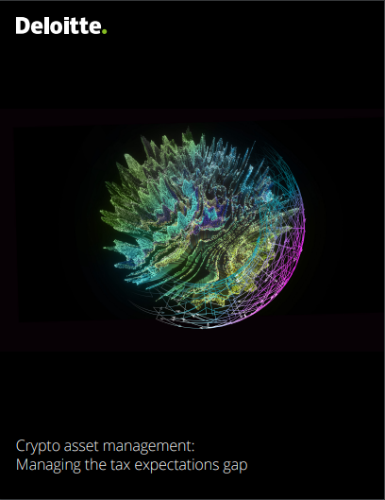
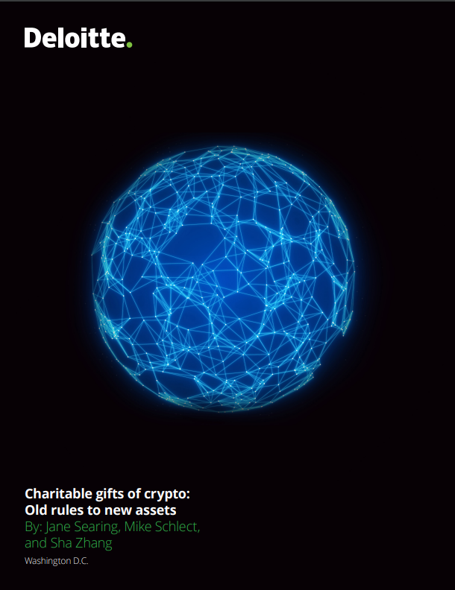

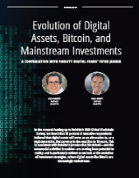
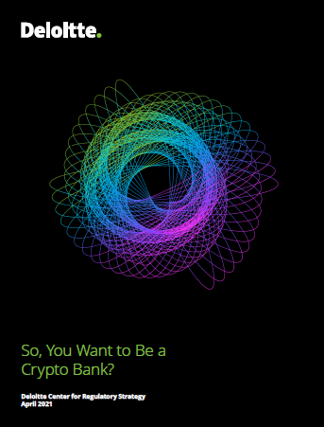
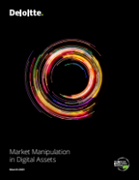
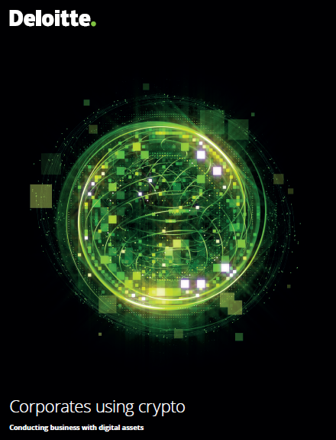
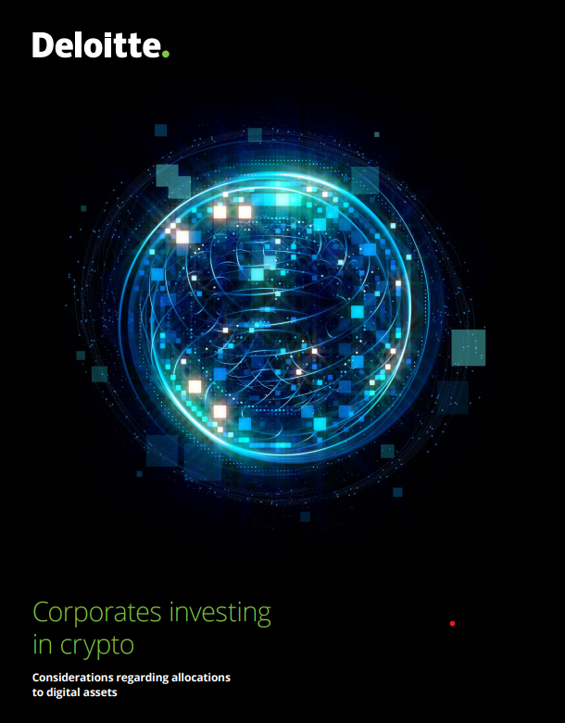
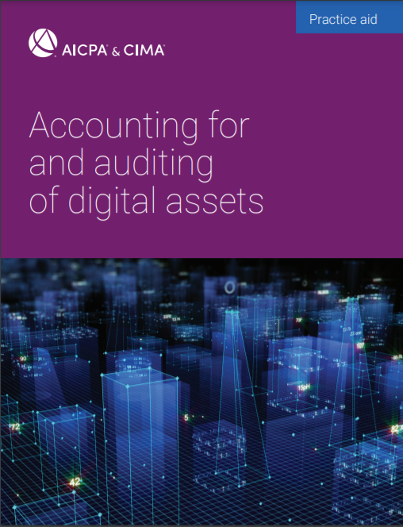
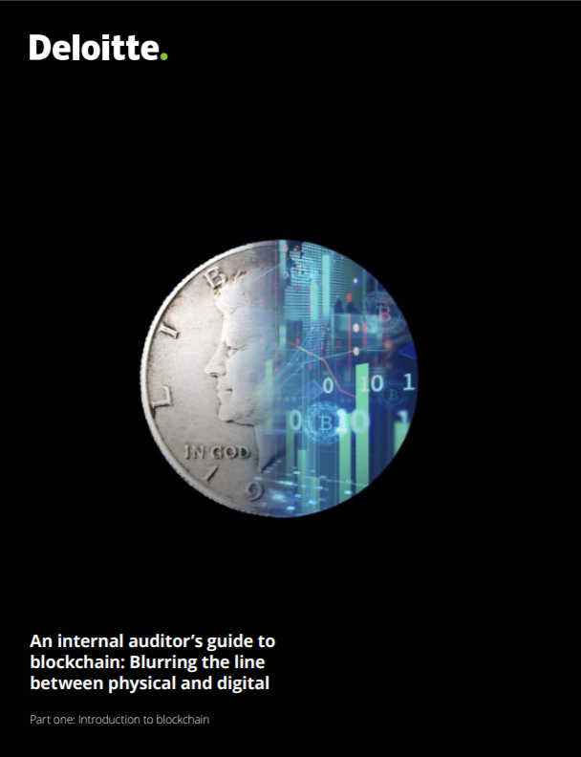
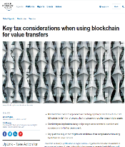
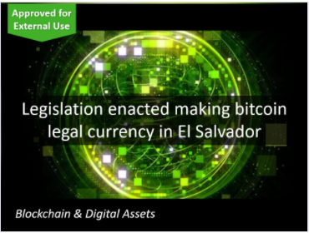
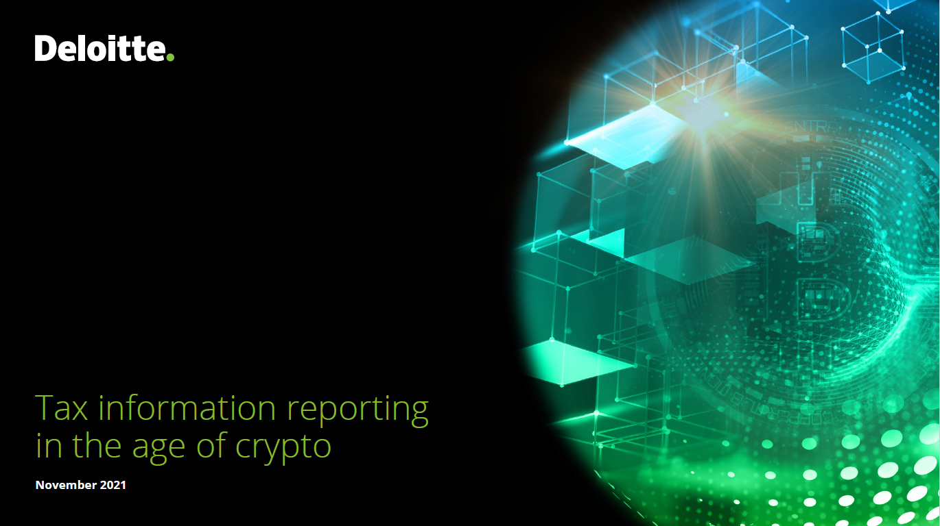

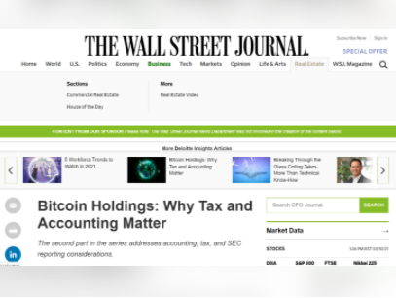
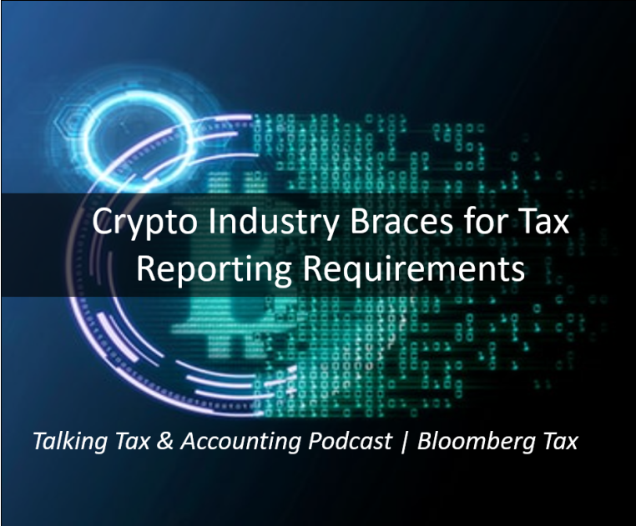
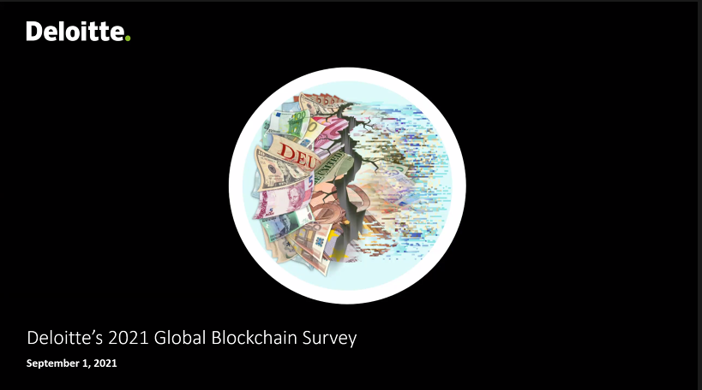
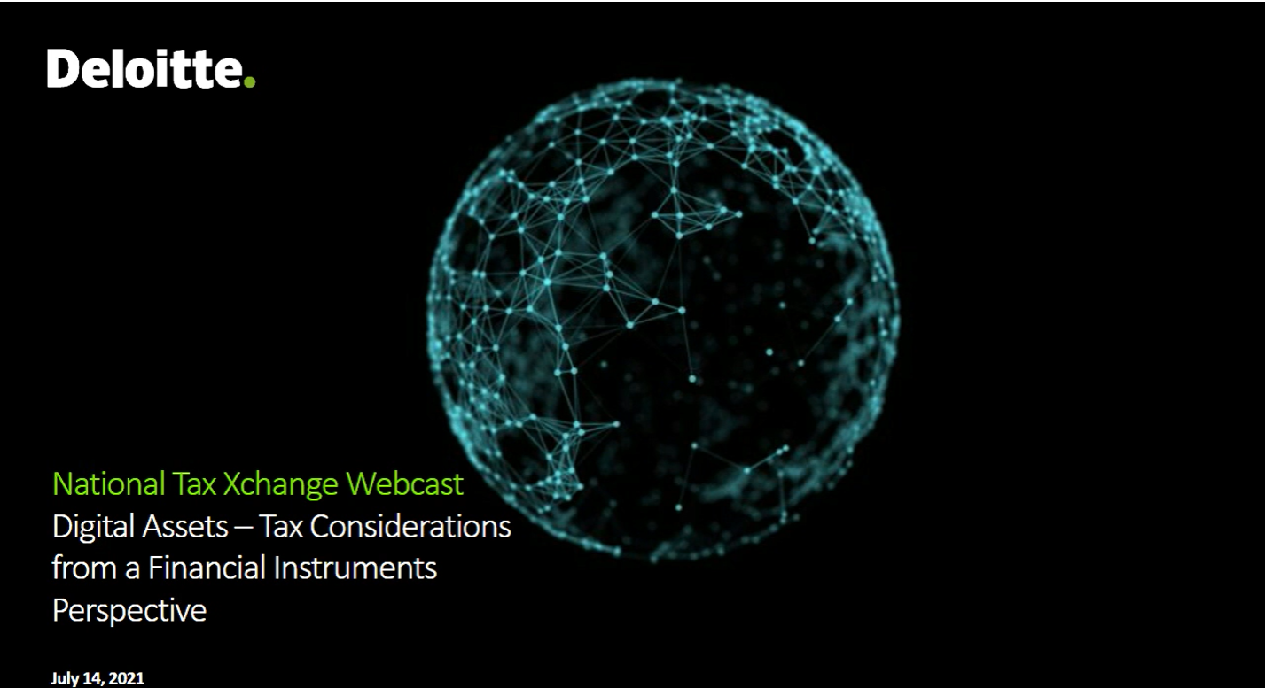
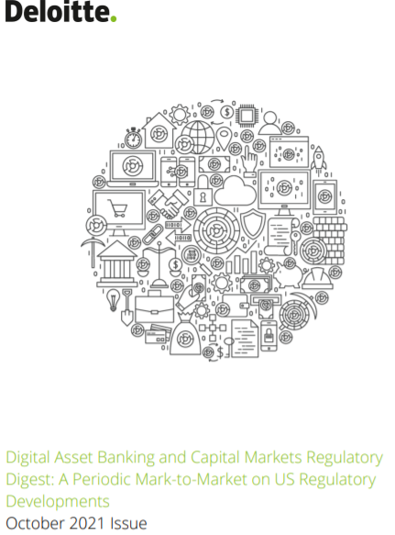
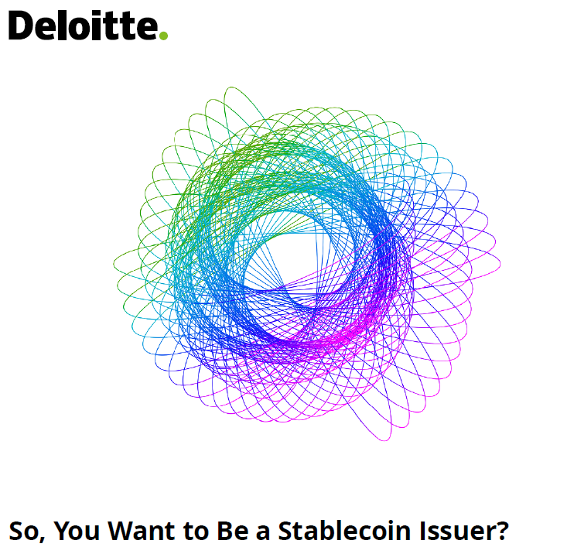
Publications and Research Papers: Current
Crypto Asset Management: Managing the tax expectation gap – March 2022
Charitable gifts of crypto: Old rules to new assets – March 2022
Stablecoin regulatory update and enhanced framework - Feb 2022
Evolution of Digital Assets Article: A Conversation with Fidelity Digital Funds’ Peter Jubber – 2021
So, You Want to Be a Crypto Bank? – Deloitte Center for Regulatory Strategy April 2021
Market Manipulation in Digital Assets – 2021
Corporates Using Crypto POV – April 2021
Corporates Investing in Crypto – 2021
Accounting for and auditing of digital assets Jan 2022
Legislation enacted making bitcoin legal currency in El Salvador - Jan 2022
US Tax Information Reporting in the age of Crypto – Nov 2021
Crypto Going Mainstream – Oct 2021
Bitcoin Holdings: Why Tax and Accounting Matter – CFO Journal – WSJ – 2021
Talking Tax & Accounting Podcast | Bloomberg Tax | Crypto Industry Braces for Tax Reporting Requirements – 2021
An internal auditor’s guide to blockchain
WEF: Key tax considerations when using Blockchain for value transfers – 2021
Deloitte’s 2021 Global Blockchain Survey: A new age of digital assets 2021
Digital Assets: Tax Considerations from a Financial Instruments Perspective – 2021
Digital Asset Banking and Capital Markets Regulatory Digest 2021
So, You Want to Be a Stablecoin Issuer? 2021

Slide 9
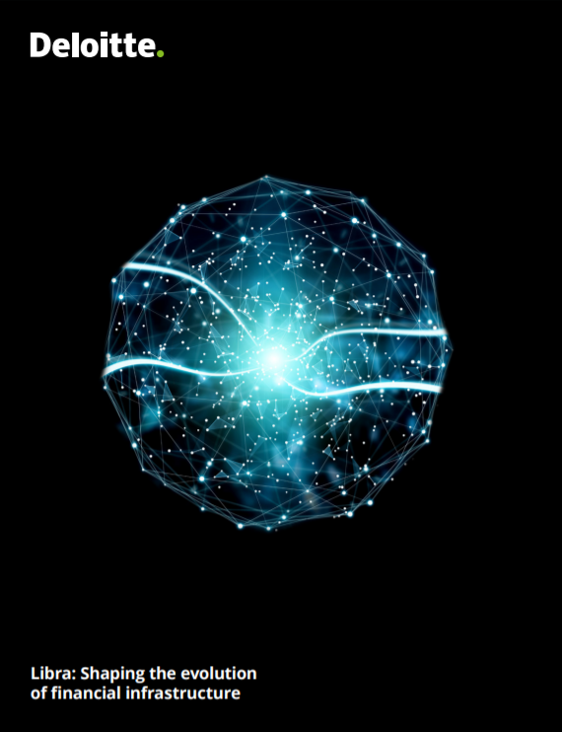
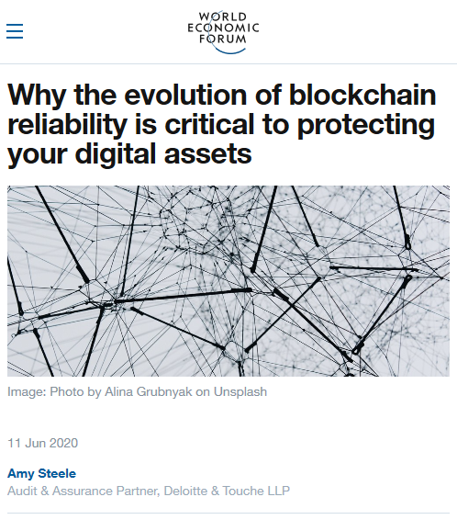

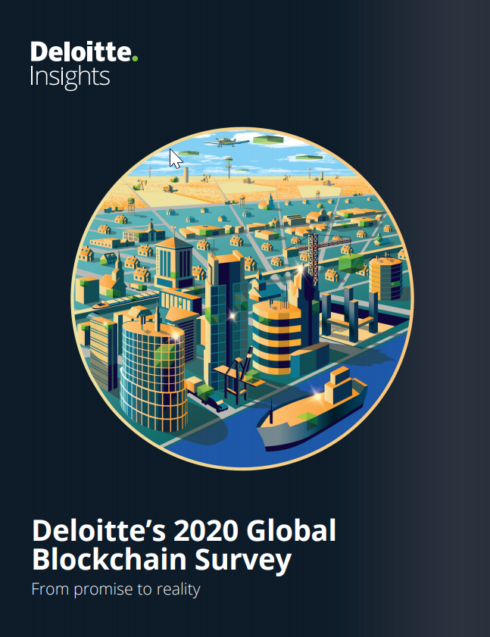
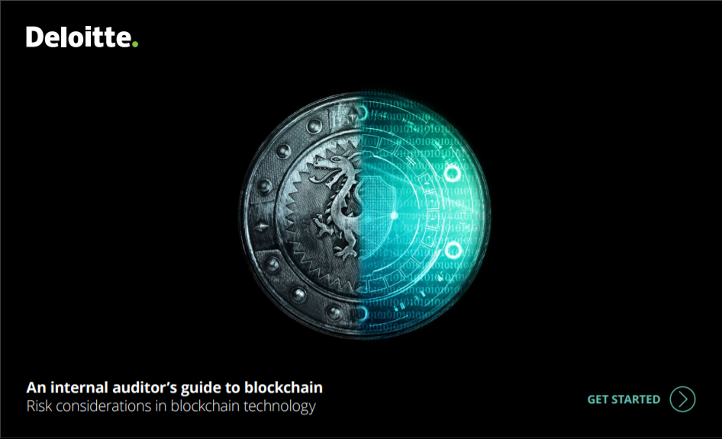



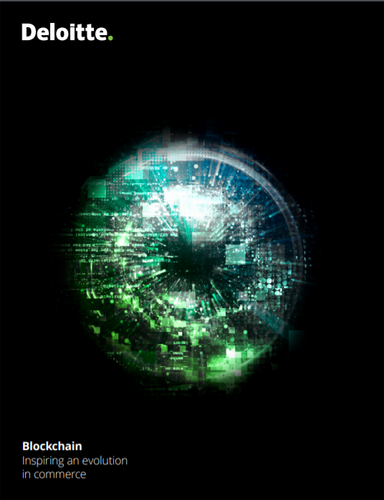
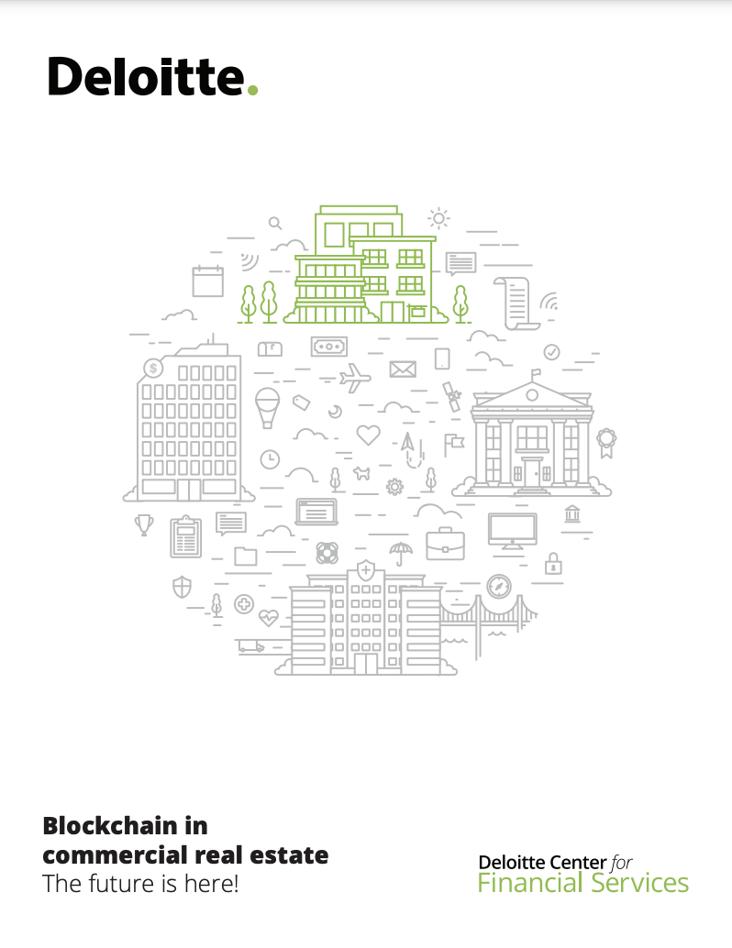
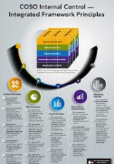
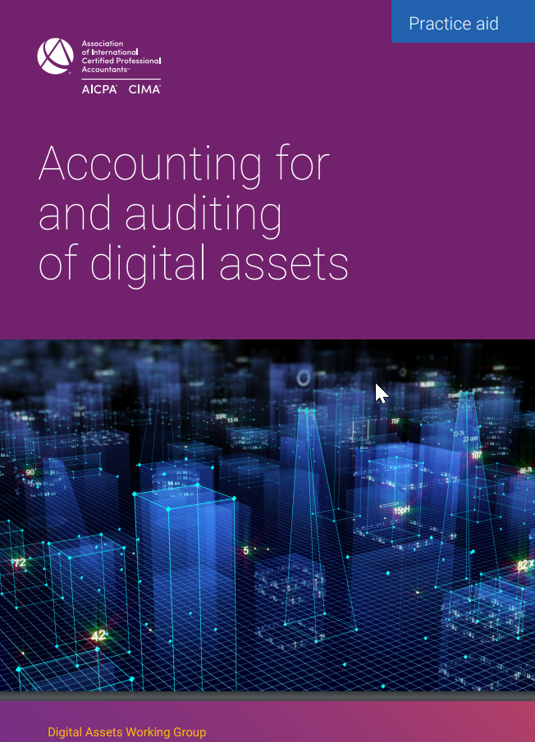

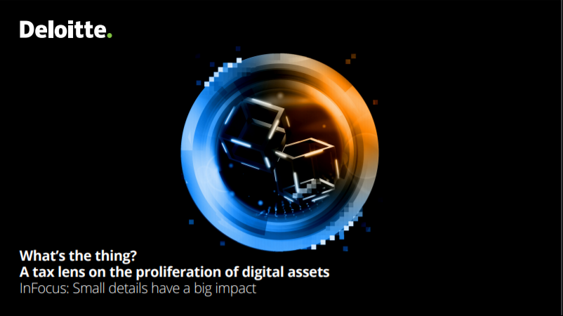
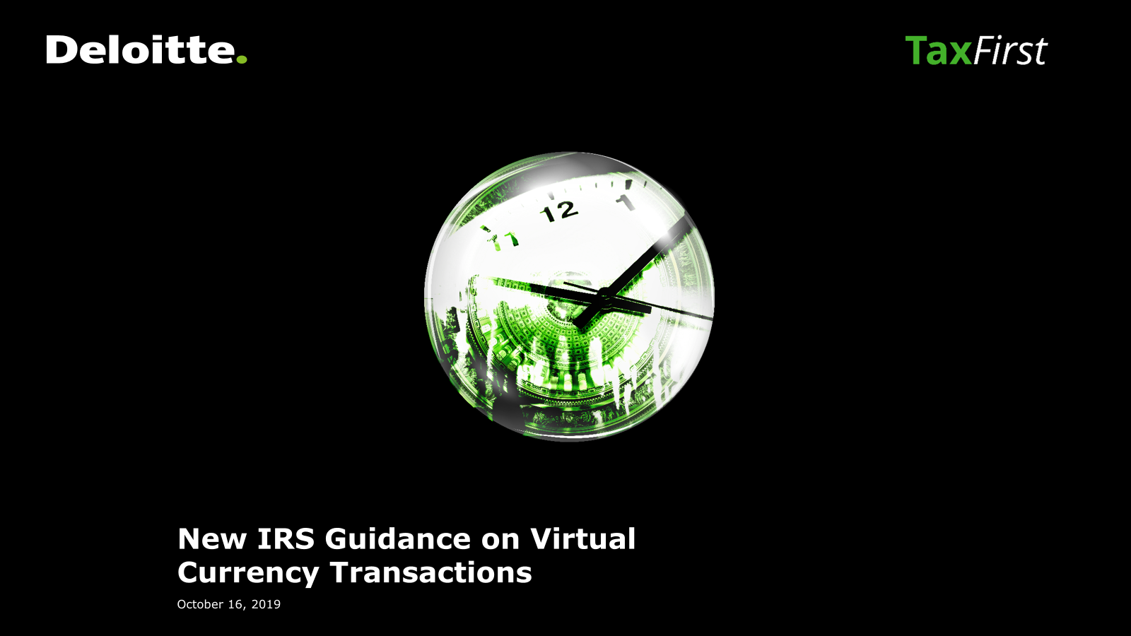

Publications and Research Papers: Legacy
An internal auditor’s guide to auditing blockchain
Libra: Shaping the evolution of financial infrastructure
WEF Agenda Article: Blockchain Reliability – 2020
Are Tokens the Securities of Tomorrow?
Deloitte’s Global Blockchain Survey – 2020
Blockchain Impact on the Audit Profession 2018
Ten things to consider about OCC guidelines on digital asset custody
Are CBDCs the Money of Tomorrow?
A Tax Lens on the Proliferation of Digital Assets
WEF: Decentralized Finance (DeFi) Policy-Maker Toolkit
The future of blockchain and market disruptors
Blockchain in Commercial Real Estate
Blockchain and Internal Control – 2020
AICPA Digital Assets Practice Aid – 2020
Additional IRS guidance on virtual currency transactions
OCC’s interpretive letter clarifying stablecoin-related activities for national banks and federal savings associations

Slide 10

Thank You.
This presentation contains general information only and Deloitte is not, by means of this presentation, rendering accounting, business, financial, investment, legal, tax, or other professional advice or services. This presentation is not a substitute for such professional advice or services, nor should it be used as a basis for any decision or action that may affect your business. Before making any decision or taking any action that may affect your business, you should consult a qualified professional advisor. Deloitte shall not be responsible for any loss sustained by any person who relies on this presentation.
About Deloitte
Deloitte refers to one or more of Deloitte Touche Tohmatsu Limited, a UK private company limited by guarantee (“DTTL”), its network of member firms, and their related entities. DTTL and each of its member firms are legally separate and independent entities. DTTL (also referred to as “Deloitte Global”) does not provide services to clients. In the United States, Deloitte refers to one or more of the US member firms of DTTL, their related entities that operate using the “Deloitte” name in the United States and their respective affiliates. Certain services may not be available to attest clients under the rules and regulations of public accounting. Please see www.deloitte.com/about to learn more about our global network of member firms.
Copyright © 2021 Deloitte Development LLC. All rights reserved.

